Slide 1
BROADBAND ELEMENTS

Slide 2
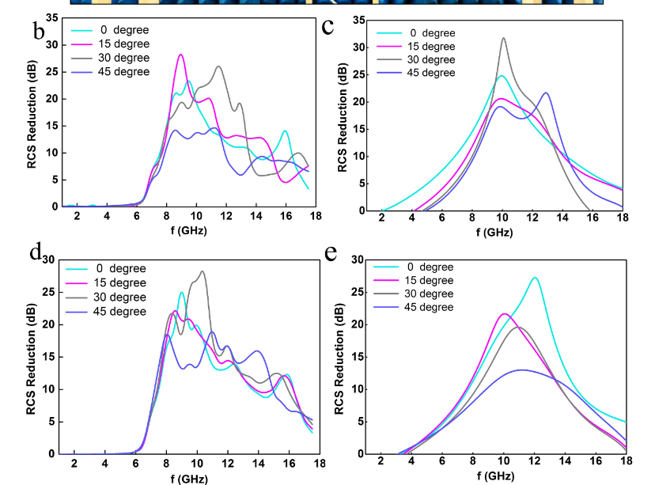
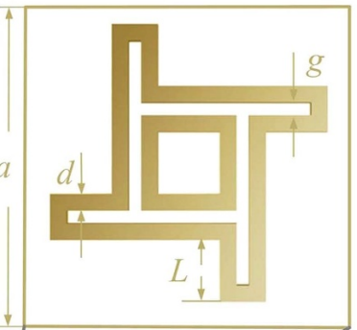
WINDMILL SHAPED ELEMENT
DIMENSIONS: s a=12 mm, g=0.4 mm, d=0.55 mm, h=4 mm
ARRAY SIZE: 16 by 16 elements
BANDWIDTH: 7 GHz to 14 GHz
It is composed of an inner square ring and an outer irregular ring, and their resonance frequencies are designed to be very close in order to increase the operation bandwidth and the reflection phasing range.
8 windmill-shaped elements with different dimensions have been selected as the composing units. When the length of the branch L is 0.6 mm, 0.825 mm, 1.05 mm, 1.26 mm, 1.47 mm, 1.75 mm, 2.05 mm and 2.38 mm respectively, the reflected phase is 45*n( n=1 to 8) degrees at the central frequency f =10 GHz.
PSO algorithm has been used for optimization.
..\OneDrive\Desktop\FYP_PAPERS\WINDMILL ELEMENT.pdf

Slide 3
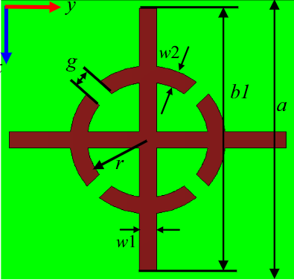
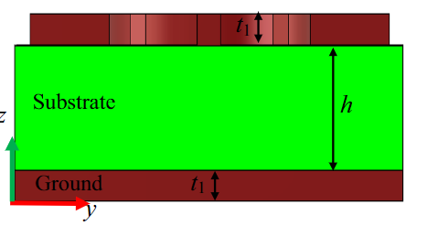
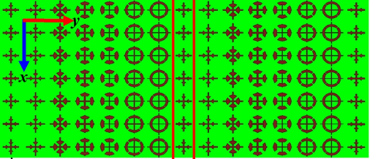
CROSS SHAPED ELEMENT
DIMENSIONS: The size parameters of b1, l, g, w1 and w2 are : (1) b1 = 5.5, g = 1.2, l = 1.6, w1 = 0.5, w2 = 0.4, (2) b1 = 6.5, g = 1.2, l = 1.5, w1 = 0.4, w2 = 0.8, (3) b1 = 7.0, g = 0.8, l = 1.75, w1 = 0.4, w2 = 1.2, (4) b1 = 6.5, g = 1.2, l = 2.5, w1 = 0.5, w2 = 1.0, (5) b1 = 6.5, g = 1.2, l = 2.5, w1 = 0.2, w2 = 1.2, (6) b1 = 7.0, g = 0.4, l = 2.75, w1 = 0.3, w2 = 0.8, (7) b1 = 8.0, g = 0.2, l = 2.75, w1 = 0.2, w2 = 0.8, length units are mm.
ARRAY SIZE: 28 × 28 elements (238 mm × 238 mm).
BANDWIDTH: 8 GHz to 20 GHz
This paper presents a low Q-factor cross-shaped unit for the design of metasurface with wide bandwidth of anomalous reflection.
The unit has a reflectance of more than 97% in the frequency range of 8.0–20.0 GHz, and a phase shift of approximate 2π can be achieved by changing the geometric parameters of the unit. Hence it is ensured that the design of the phase gradient metasurface has a wider bandwidth.
Seven units with different reflection phases are used to design the phase gradient metasurface. The phase difference between the last cell of the previous cycle and the first cell of the next cycle is 360°.
..\OneDrive\Desktop\FYP_PAPERS\CROSS-SHAPED ELEMENT.pdf

Slide 4
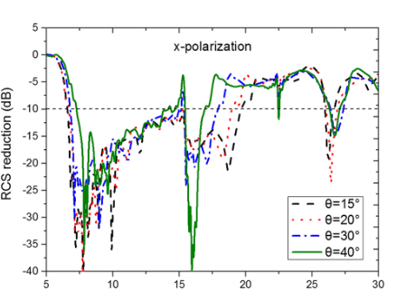
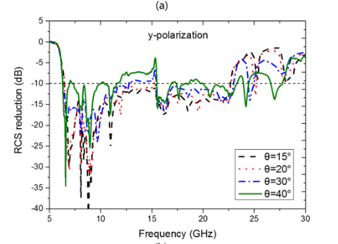
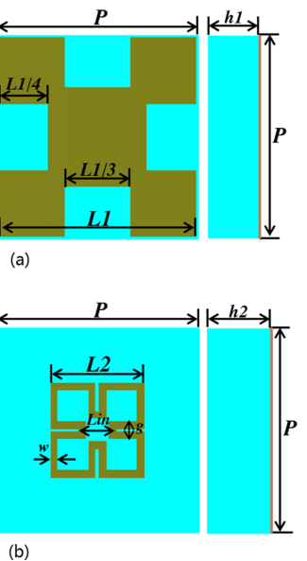
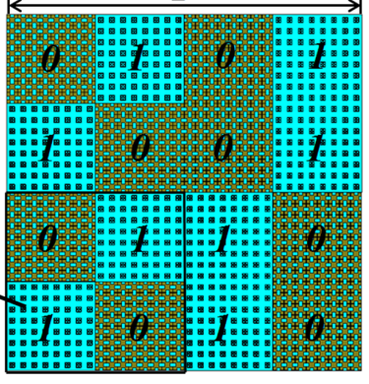
MINKOWSKI FRACTAL ELEMENT
DIMENSIONS:
h1=2mm, h2=6 mm, L1= 7.8 mm and L2=3.7mm both with the step size of 0.1 mm. P=8 mm, w=0.3 mm, Lin=1.5 mm and is g=0.7 mm.
ARRAY SIZE: 256 mm × 256 mm
BANDWIDTH: 6.6 to 23.9 GHz
Minkowski Fractal element is chosen as the basic unit cell on account of its fractal geometry with an excellent self-similar property, which is useful for adjusting the unit cell size and broadening the working bandwidth, in addition, the simple design and the easy fabrication.
1-bit coding metamaterials, artificially regulate “0” element with a 0 degree phase response and “1” element with a 180 degree phase response.
The particle swarm optimization (PSO) algorithm combining with the array theory are utilized to optimize the coding matrix of digital elements and obtain the optimal layout for diffusion scattering under normal incidence.
..\OneDrive\Desktop\FYP_PAPERS\MINKOWSKI FRACTAL ELEMENT.pdf

Slide 5
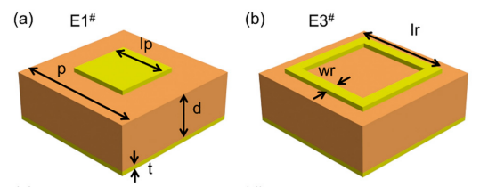
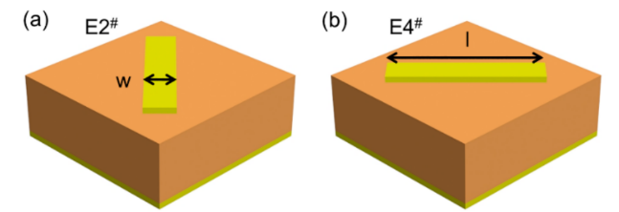
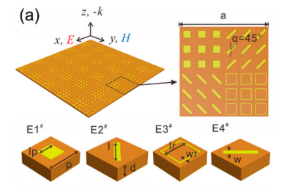
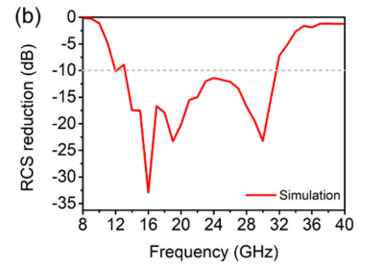
QUARTERNIONIC ELEMENT
DIMENSIONS: p=6 mm, lp=2.8 mm, lr=4.5 mm, and wr=0.5 mm. ,t = 0.035 mm and d=2 mm, l=5 mm w=1 mm
ARRAY SIZE 180 mm × 180 mm × 2 mm
BANDWIDTH: 12.7–33.8 GHz
A quaternionic metasurface consisting of two pairs of units with destructive phase differ-ence is proposed to extend the bandwidth of radar cross section (RCS) reduction. The two pairs of units are designed to have complementary phase-different bandwidth, which extends the bandwidth of RCS reduction. The overlaps of their bandwidth enhance the RCS reduction, resulting in a meta-surface having broadband and strong RCS reduction.
cut-wire patterns arranged at 45 degrees and 135 degrees can achieve 180 phase difference in the maximum frequency range.
..\OneDrive\Desktop\FYP_PAPERS\QUATERNIONIC.pdf

Slide 6
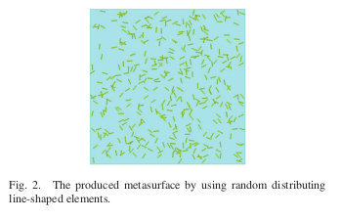
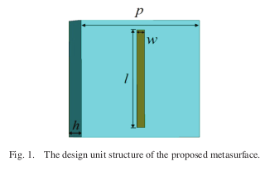
RANDOM L SHAPED ELEMENTS
There are 300 metal wires with length
of 4 mm and 300 metal wires with length of 6 mm.
The metal cut-wire have diameter of 0.3 mm.
Bandwidth: 9.5Ghz
Achieved good diffusion scatter performance with polarization independent characteristic.
Due to the random position and rotate angle, various kinds of phase grads are brought into the produced metasurface.
And the random phase gradients are obtained.
The incident wave is scattered in many directions and the diffuse scatter characteristic is achieved.

Slide 7
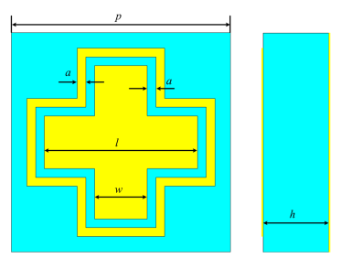
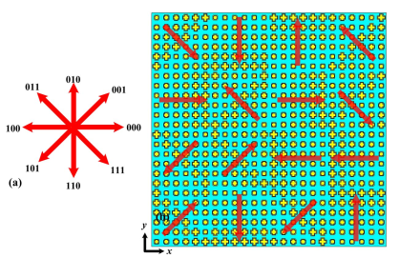
CROSS WIRE ELEMENTS
PHASE GRADIENT:
p = 10 mm, a = 0.4 mm, and w = 2.4 mm
six unit cells with l = 3.6 mm, 4.23 mm, 4.72 mm, 5.27 mm, 6.04 mm and 6.77 mm are the oblique-gradient and horizontal-gradient supercells.
RANDOM COMBINATORIAL PHASE GRADIENT:
3 bit coding - Eight types of supercells were designed to deflect the scattering into eight different directions with a
step of π/4 across the azimuth plane.
4 × 4 supercells with 240 mm × 240 mm
BW: 7 to 15.6Ghz

Slide 8
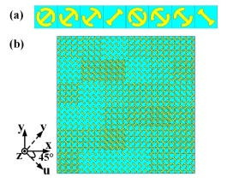
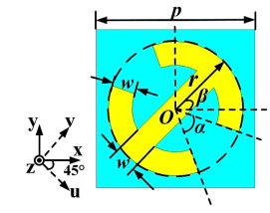
3 BIT CODING METASURFACE
p = 10 mm, r = 4.25 mm, w = 1.5 mm, 240 mm × 240 mm
α represents the open angle of the symmetric split ring and β is the rotation angle of unit cell.
U- and v-axes are along 45° direction with respect to x and y direction.
Varying α, β give 8 coding patterns of different phases
BandWidth:6 – 18Ghz

Slide 9
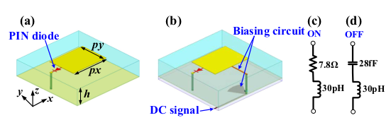
PROGRAMMABLE METASURFACES
perfect binary coding phase is achieved at the design frequency of 11.1 Ghz.
A pin diode is employed to connect one edge of the patch to the ground through a metal via.
GA along with IFFT is used to synthesize radiation pattern.
Programmable Unit Cells: 400*400

